Slide 1
Chronology and Timelines

Slide 2
Chronology
Placing events in chronological order means putting them in the order in which they happened.
Using this system, an event that happened in 1802 would come before an event that happened in 1902.

Slide 3
Chronological Order
There are a few ways to organize events in chronological order.
One way is to make a list of events, with the events that happened first appearing at the top of the list.
For example, the list below is in chronological order:
Arrival of the Pilgrims on the
Mayflower
Signing of the Declaration of Independence
The War of 1812
The Battle of Gettysburg
Assassination of President Abraham Lincoln
World War I
The Great Depression
Japanese attack on Pearl Harbor
First walk on the moon by astronaut Neil Armstrong
Space Shuttle Challenger accident
Desert Storm (The Persian Gulf War)

Slide 4
Timelines
One common way of putting events in chronological order is by creating a timeline.
Timelines are read from left to right or from top to bottom and are marked by years, decades, or centuries.
Two or more timelines put together to compare different events in the same era is called a "multi-tier timeline."

Slide 5
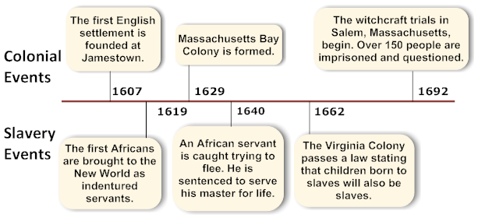
Timelines
The timeline below is an example of a multi-tier timeline comparing events from the 1600s.

Slide 6
Measuring Time & Time Concepts
There are different ways that time is measured.
Time can be measured by minutes, hours, days, years, decades, and centuries.
Year — There are 365 days in one year.
This is the amount of time it takes the Earth to orbit the sun.
Decade — There are 10 years in a decade.
For example, the 1990s represent one decade, or the years of 1990 to 1999.
Century — There are 100 years in a century.
For example, the years 1901 to 2000 are one century, called "the twentieth century."

Slide 7
Measuring Time & Time Concepts
Millennium — There are 1,000 years in a millennium.
For example, the years 1001 to 2000.
Era — An era is a period of time marked by a special event or leader.
An era is not a set number of years.
Examples include the Victorian Era (marked by Queen Victoria's rule over Great Britain) and the Civil War Era (the time of the American Civil War during the 1860s).
Another word for "era" is "age" or "period."

Slide 8
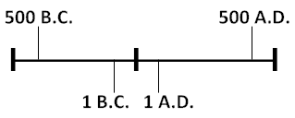
Understanding B.C. and A.D.
B.C. or B.C.E.
B.C. means "Before Christ"
B.C.E. means "Before the Common Era."
These are the years before 1 A.D.
It is important to remember that the year 500 B.C. and 500 B.C.E. mean the same thing.
It is also important to know that, for the years prior to 1 A.D., we count backwards.
This means that 400 B.C. occurred before 200 B.C.

Slide 9
Understanding B.C. and A.D.
A.D. or C.E.
A.D. means "Anno Domini" (in the year of our Lord)
C.E. means the "Common Era."
Having a year marked as either A.D. or C.E. refers to years starting with 1 A.D. to the present-day.
For the A.D. or C.E. years, we count forward.
This means that 1997 occurred after 1392.

Slide 10
Dates on a Timeline
B.C. and B.C.E. dates go from higher numbers
(500 B.C. or B.C.E.) to lower numbers
(200 B.C. or B.C.E.).
A.D. and C.E. dates go from lower numbers
(100 A.D. or C.E.) to higher numbers
(2001 A.D. or C.E.)
B.C. or B.C.E 0 A.D. or C.E.
(#’s decrease as time passes) (#’s increase as time passes)
Birth of Jesus
500 BC | 375 BC | 250 BC | 125 BC | 508 AD | 1008 AD | 1508 AD | 2008 AD

Slide 11
Interpreting a Timeline
Which year is closer to the present or today?
25 B.C., 2000 B.C., 500 B.C.E., 125 B.C.E.
2012 B.C.E., 2000 C.E., 1500 B.C.E., 2010 C.E.
How many years are between the dates below?
375 B.C. and 125 B.C.
125 B.C. and 500 A.D.
250 B.C.E. and 1500 C.E.

Slide 12
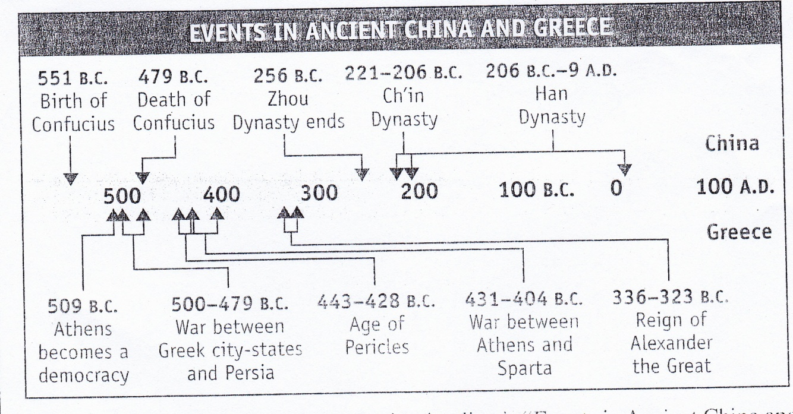
Interpreting Multiple-Tier Timelines
What is the title of the timeline?
How many years are covered in B.C.? A.D.?
How many years TOTAL does the timeline cover?

Slide 13
Why do we use BCE/CE and BC/AD?
Although Christians make up a large part of the world’s population, they are less than a majority.
*As a result, B.C.E. is often used by those who wish to avoid a reference
to Christianity.
The date A.D. 1 was first used when Jesus was born.
* However, later it became evident that Jesus was not actually born that
year, but a few years earlier.
Because of a variety of changes and adjustments that were made to the calendar during the Middle Ages, it appears that Jesus was probably born
in 6 B.C. and most likely lived until 30 A.D.
* Using C.E., or Common Era, allows the same historic period to be used
even though the estimate for when Jesus was born has changed.

