Slide 1
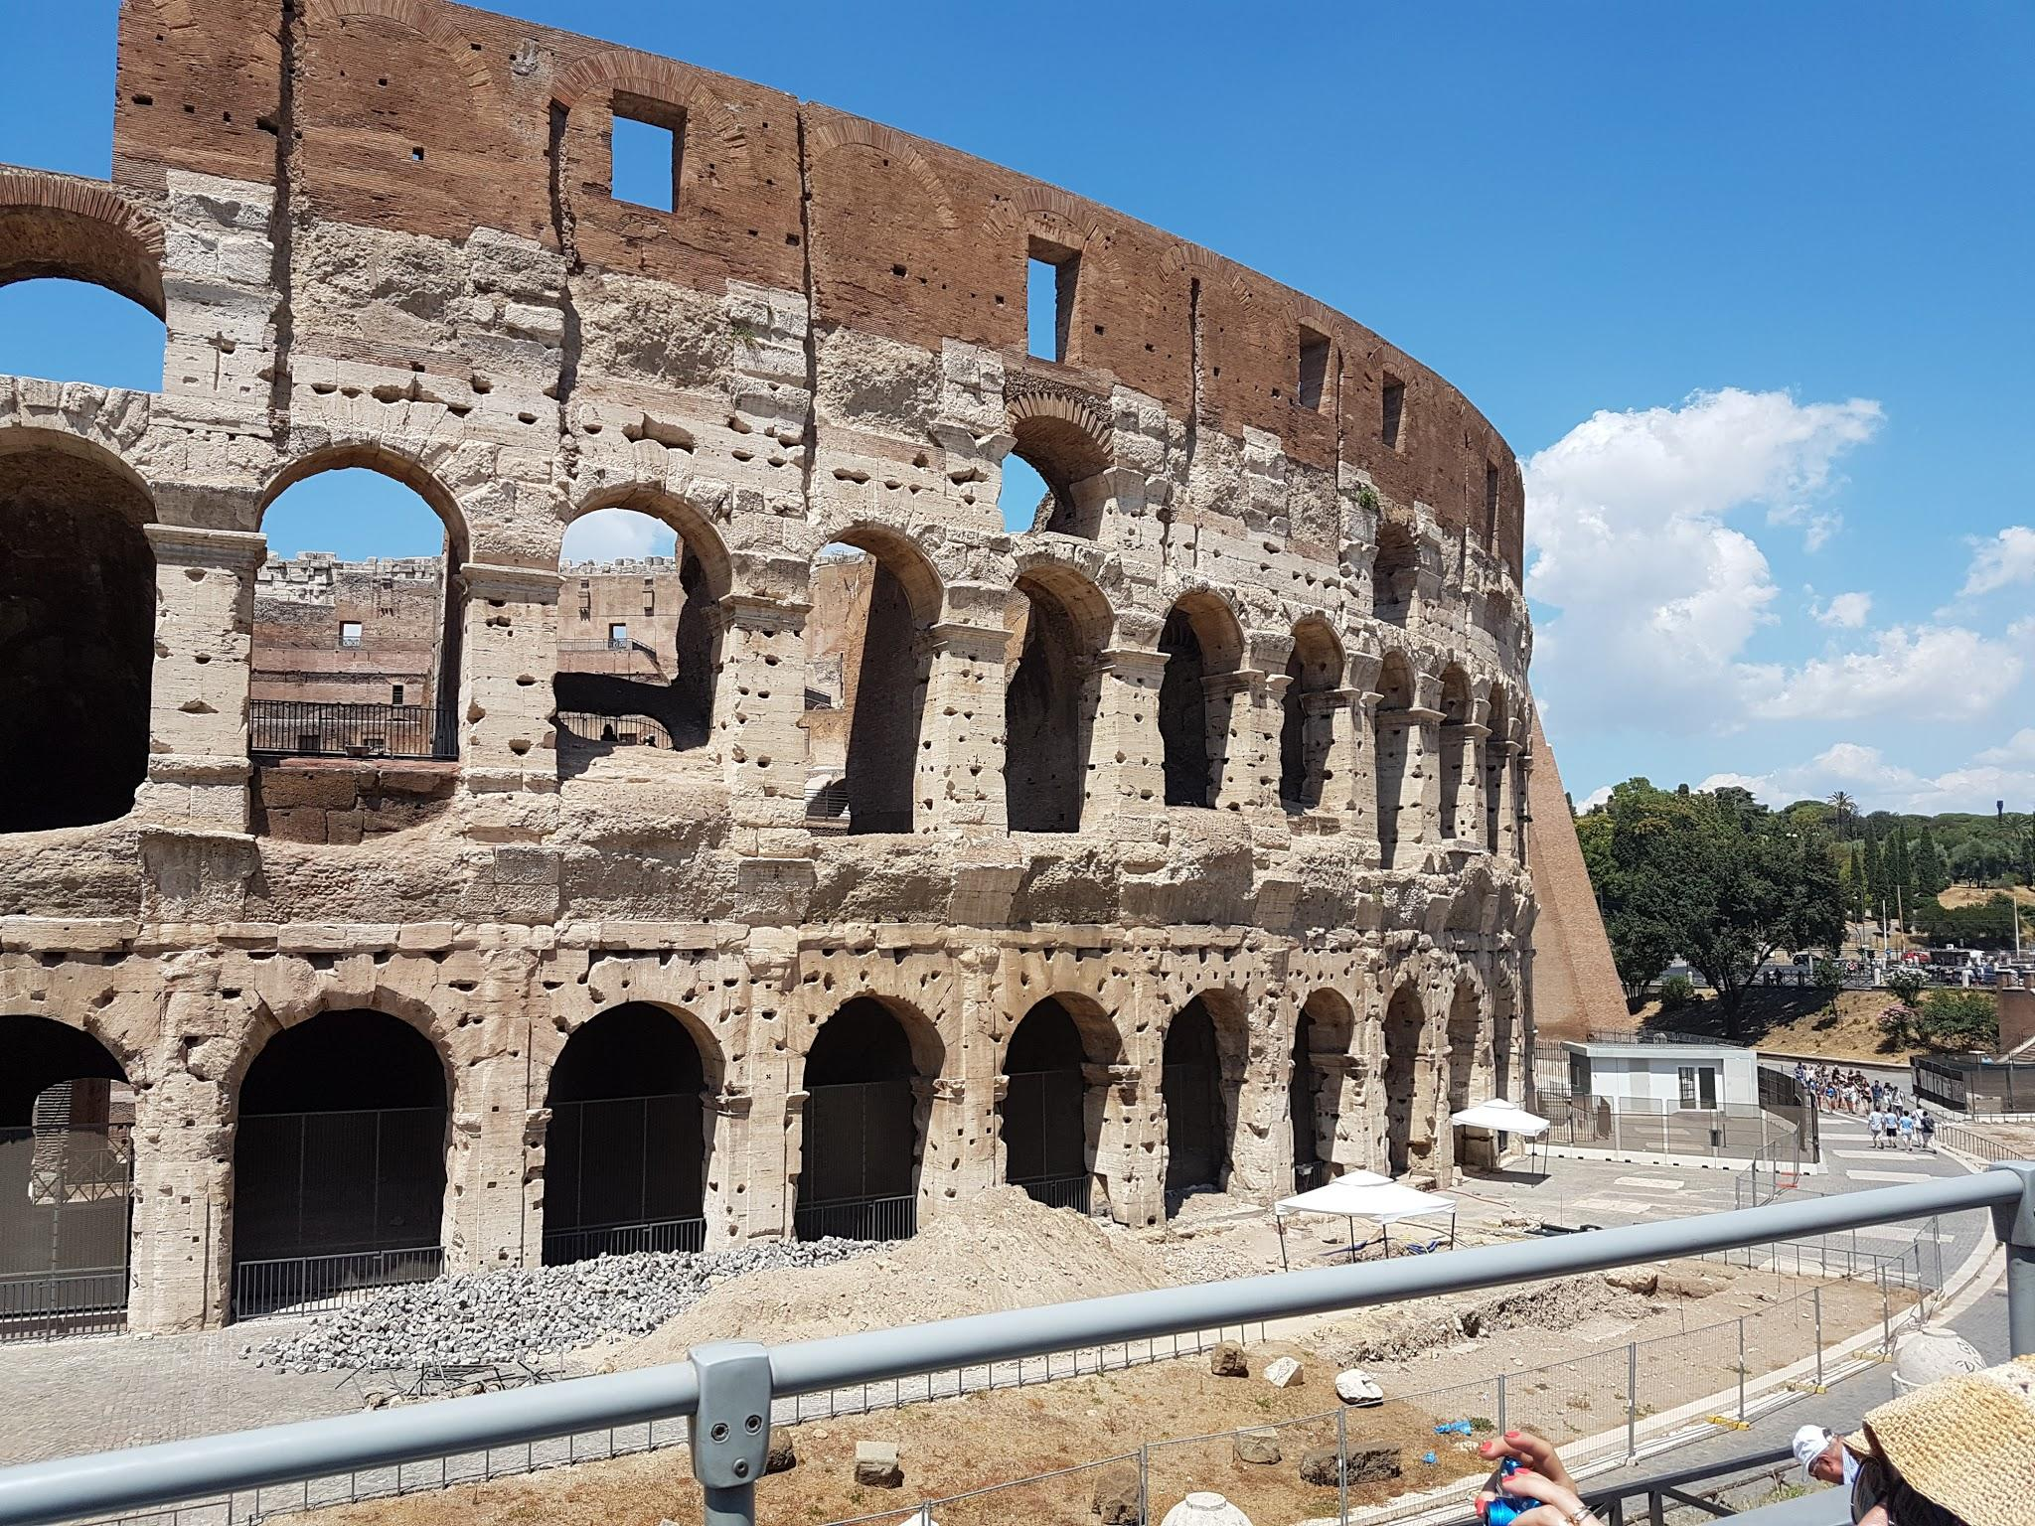
Welcome to 6th Grade Social Studies

Slide 2
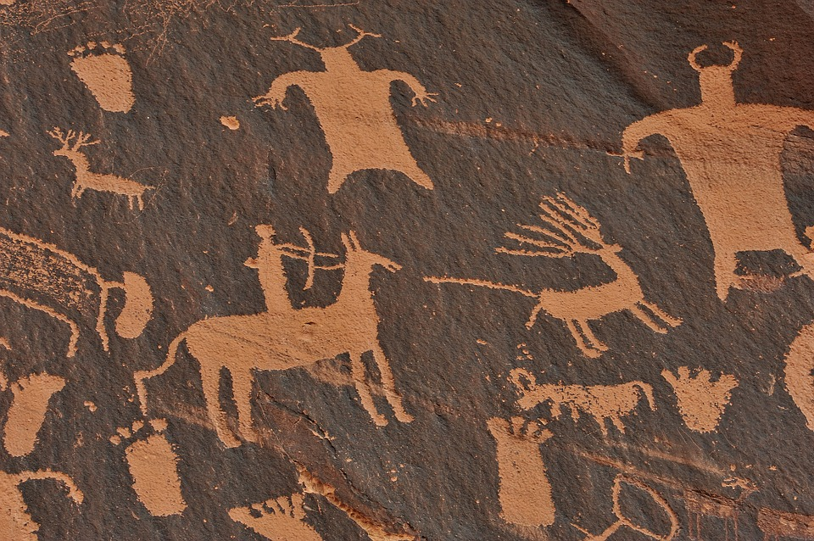
What will your child be learning about this year???

Slide 3
Curriculum:
Geography & Map Skills
Prehistoric Records/Beginning of Mankind
Paleolithic
Mesolithic
Neolithic
Ancient Civilizations
Mesopotamia
Egypt
India
China
Greece & Rome
Middle Ages & Renaissance
Mayas & Aztecs & Incas

Slide 4
What is GRAPES???
This is a way we shared with the kids to keep reviewing with every civilization we learn about this school year. We will always come back to GRAPES.
G - Geography
R - Religion
A - Accomplishments/Achievements
P - Politics/Government
E - Economics
S - Social Structure

Slide 5
What are they expected to have for class?
Social Studies Interactive Notebook (Composition Notebook)
Pencils
Scissors
Glue Stick
Agenda
Book to read EVERY DAY
Ask your student or check website for when devices are needed.

Slide 6
Helpful Apps/Websites:
Free QR code reader on device--use this article to guide your decision or simply use this QR code reader
Google Classroom
Google Drive
With any Google application, please make sure your student is logged in to Google through their WakeID account in order to access the WCPSS Google tools
rabbhistory.weebly.com

Slide 7
Grading Expectations:
Tests: Every child who scores a 79% or less will be given the opportunity to improve their grade.
Quiz : Teacher may allow either a retake or corrections to be made. This is dependent on assignment given.
Classwork/Homework: Grades earned are final. (Late work gets deductions)
90 - 100 = A
80 - 89 = B
70 - 79 = C
60 - 69 = D
59 and below = F

Slide 8
Student Absences and Work Missed:
Q: What is my student’s responsibility when she/he is absent?
A: Per AFMS Grading Policy:
“For absences of one to three days, the student will have one day for each day absent. For absences exceeding three days, the student may have two days for each day absent to make up work. Teachers should use discretion and may make exceptions in the case of students with excused absences that were not planned in advance, were beyond the student’s control, and the nature of which would not support make-up the day of return. There is no academic penalty for make-up work completed in the time frame stated above. All assignments are graded for full credit earned.”

Slide 9
Grading Expectations:
Tests: Major grades = weighted 50%
Quiz : Minor grades = weighted 40%
Classwork : Minor grades = weighted 40%
Homework : Homework grades = weighted 10%
No late assignments accepted after:
Q1 - October 12, October 30
Q2 - November 30, Jan. 16
Q3 - February 15, March 26
Q4 - May 3, June 7

Slide 10
Helpful Resources:
Team Website:
https://sites.google.com/wcpss.net/troopersteam/home
Teacher Email:
erabb@wcpss.net

